Slide 1
A Child’s Brain
Jingyu Cui, Mother of two

Slide 2
Disclaimer
I am only a parent, not a neuroscientist; All information presented here is only from my reading, my own understanding. Please use at your own risk.

Slide 3
Brain development is long process
The growth and maturation of a child’s brain is an intricate process taking decades, in which the brain grows and adapts to the surrounding world.
It is a lot longer than the first three years.

Slide 4
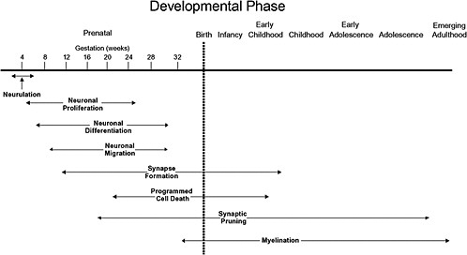

Slide 5
Brain That Builds Itself
Take a Breath and Relax: Children grow like dandelions.
Babies’ minds are very complex right out of the box:
Babies can detect how common or rare particular events are.
Babies use coincidences to draw conclusions about cause and effect.
Babies distinguish objects from agents.
Babies organize information into categories and people into groups.
Babies select relevant information for attention while discarding most of what goes on around them.

Slide 6
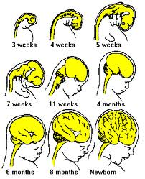
Conception to Birth
3 weeks: neural tube forms (later becomes brain and spinal cord)
6 weeks: Divides neural tube into distinct regions
Early stage of the brain development is the production of new cells
20 weeks, cells begin to differentiate
First step of the wiring process begins before birth
Synapses formation and planed cell death also start before birth

Slide 7
Babies are super-effective learners
Unlike many animals, people are not hardwired to be a good fit to their environment at birth.
Babies are equipped with the skills required to adapt to a wide variety of conditions.
The benefits of this approach are enormous, so are the cost.
BABIES are BORN TO LEARN; they are not passive learners.

Slide 8
First Two Years
It is a period of intense learning: vision, motor skills, and language.
A huge number of connections between neurons are added to the baby’s brain: a baby’s brain reaches 70% of adults size by 1st birthday; 80% by the second.
The formation of new synapses are relatively nonselective connections at this stage; then gradually the brain will remove the ones that aren’t used often enough. Life experience is like the pruning process.
Notes:
The growth is mainly in the region integrates sensory information to help guide movement (control their bodies)

Slide 9
Nature Versus Nurture
A child’s brain builds itself through largely automatic programs, and it adapts to its environment.
Genes establish a program to build a brain, but that brain reacts to the world, extensively tuning itself to local conditions as a child grows.
A child’s heredity is not destiny.
Some environmental effects on development cannot be undone, like native language.
Genes and environment are irrevocably entangled throughout your child’s life.

Slide 10
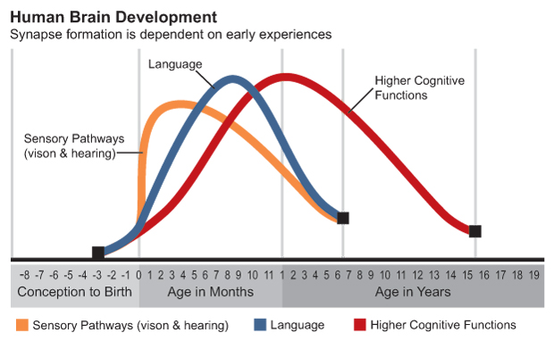
Sensitive Periods
They are the times in development when experience has a particularly strong or long-lasting effect on construction of the brain circuit.
Receiving the correct sort of experience during a sensitive period is essential for the maturation of the particular behaviors that rely on that circuitry
Different functions have their own sensitive periods

Slide 11
Sensitive Periods
Sensitive periods are most common in infants and toddlers because the brain is undergoing such dramatic growth; but they can occur at other times as well.

Slide 12
Learning Language
Babies start to learn language a long time before they are able to speak.
Young infants can distinguish and categorize the sounds of all languages of the world.
By six months to ten months, babies become better at identifying the phonemes of their native language and worse at identifying that of other languages.

Slide 13
Sensitive Periods for language
In the first year or two: phonemes
A Child’s ability to acquire syntax rules declines gradually after age eight.
Children can learn more than one native languages if they exposed to those languages early enough. Their brains appear to represent the languages somewhat separately.
Learning a second language also changes the brain. A region of the brain is larger in people who speak more than one language, and it is largest in those who learned the second language when they were young or speak it fluently.

Slide 14
Gender Difference
Most gender differences are too small to matter.
For nearly all sex differences, the differences among individual girls or boys are much larger than the average differences between gender, with a few import exceptions.

Slide 15
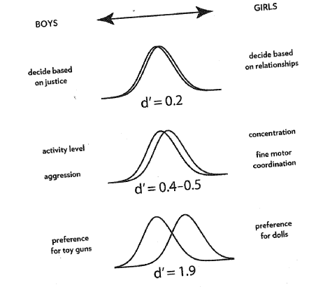
Big Gender Differences
Toy preferences: gender identiy
Boys are significantly more active and physically aggressive than girls
Girls’ brains mature earlier than boys’
Girls are moderatly better at inhibitory control
Girls are a bit more advanced in verbal development, fine motor control
Boys are better at mentally rotating objects through space (map reading, navigation)
You can still broaden your child’s abilities by introducing a variety of styles of playing

Slide 16
All other things considered
Being able to see is crucial for a child’s development. Protect children’s vision, expose children to verities of visual objects during the sensitive period is very important (Birth to five). Outdoor play improves vision.
Protect your children from noise starting before birth
Babies need to be touched (Skin to skin contact).
Learned preferences for food accumulate over the first few years of life, start in the womb, last for years.

Slide 17
Electronic Entertainment and Your Child’s Brain
A child’s brain depends on commonly available sensory experiences to help determine which neural connections should be maintained or lost.
Multi-tasking is a myth.
Young Children’s brains are strongly influenced by one-on-one interactions with caring adults.
Before age two, electronic entertainment has no benefit and cleat costs.
For older prschoolers, educational TV can be beneficial.
For school-age children, electronic media are a mixed blessing: improving some cognitive capacities, while perhaps impairing others.

Slide 18
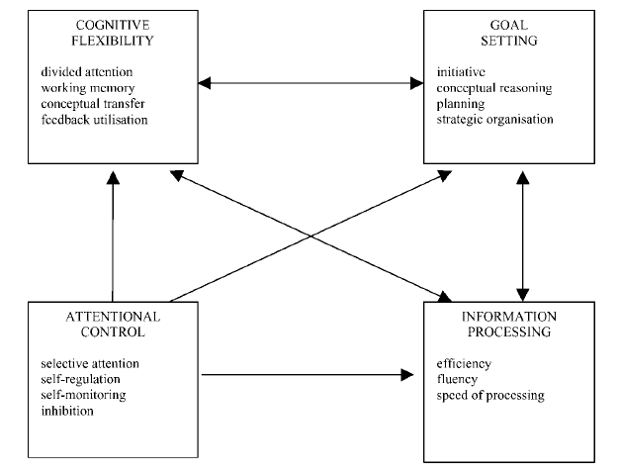
Executive Function
Learning self-control strategies at an early age can pay off for years afterward.
Effortful control (control impulse, plan actions) is first seen around 27 to 30 months of age.

Slide 19
References:
How the Mind Grows from Conception to College, Welcome to your child’s Brain, by Sandra Aamodt and Sam Wang
Assessment and Development of Executive Function (EF) During Childhood, by Peter Anderson, Child Neuropsychology: A Journal on Normal and Abnormal Development in Childhood and Adolescence, 8:2, 71-82
http://www.zerotothree.org

Slide 20
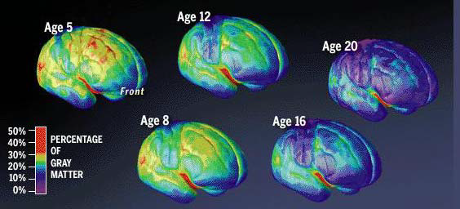
Thank You!

